Slide 1

EVENT STAKING
GROUP 4

Slide 2
Agenda
Problem Statement
Problem
Solution
Technologies
Contracts:
Reward Token
Nft
Staking
RSVP Event
Frontend/Testing
Questions
Event Safe

Slide 3
PROBLEM STATEMENT
In this post-COVID era, attempting to arrange events both virtually and in-person, has become an increasingly daunting task.
There are many individuals show initial interest by casually RSVPing to a hosted event; however, when the time comes, a fraction, if not a majority, do not attend. This creates a strenuous situation for hosts especially when others are involved such as guest speakers, bands, etc.
Considering these embarrassing and far too frequent attendance issues, we have created our last project to inspire hope in those hosts selfless enough to bring people back together [safely].

Slide 4


Inconsistent event attendance promises in a post-COVID era, creating volatility for hosts thus, decreasing event satisfaction and desensitizing hosts.

Slide 5

A Solidity, smart contract supported, event planning platform in which guests RSVP and pay a small amount to a decentralized fund. The individuals who RSVP but fail to check in, lose their staked ETH; those who do attend, get their money back and a share of the reward.

Slide 6







TECHNOLOGIES

Slide 7

CONTRACTS
Reward contract
Nft contract
Event safe contract
Staking Contract
Rsvp Event contract(MAIN)

Slide 8
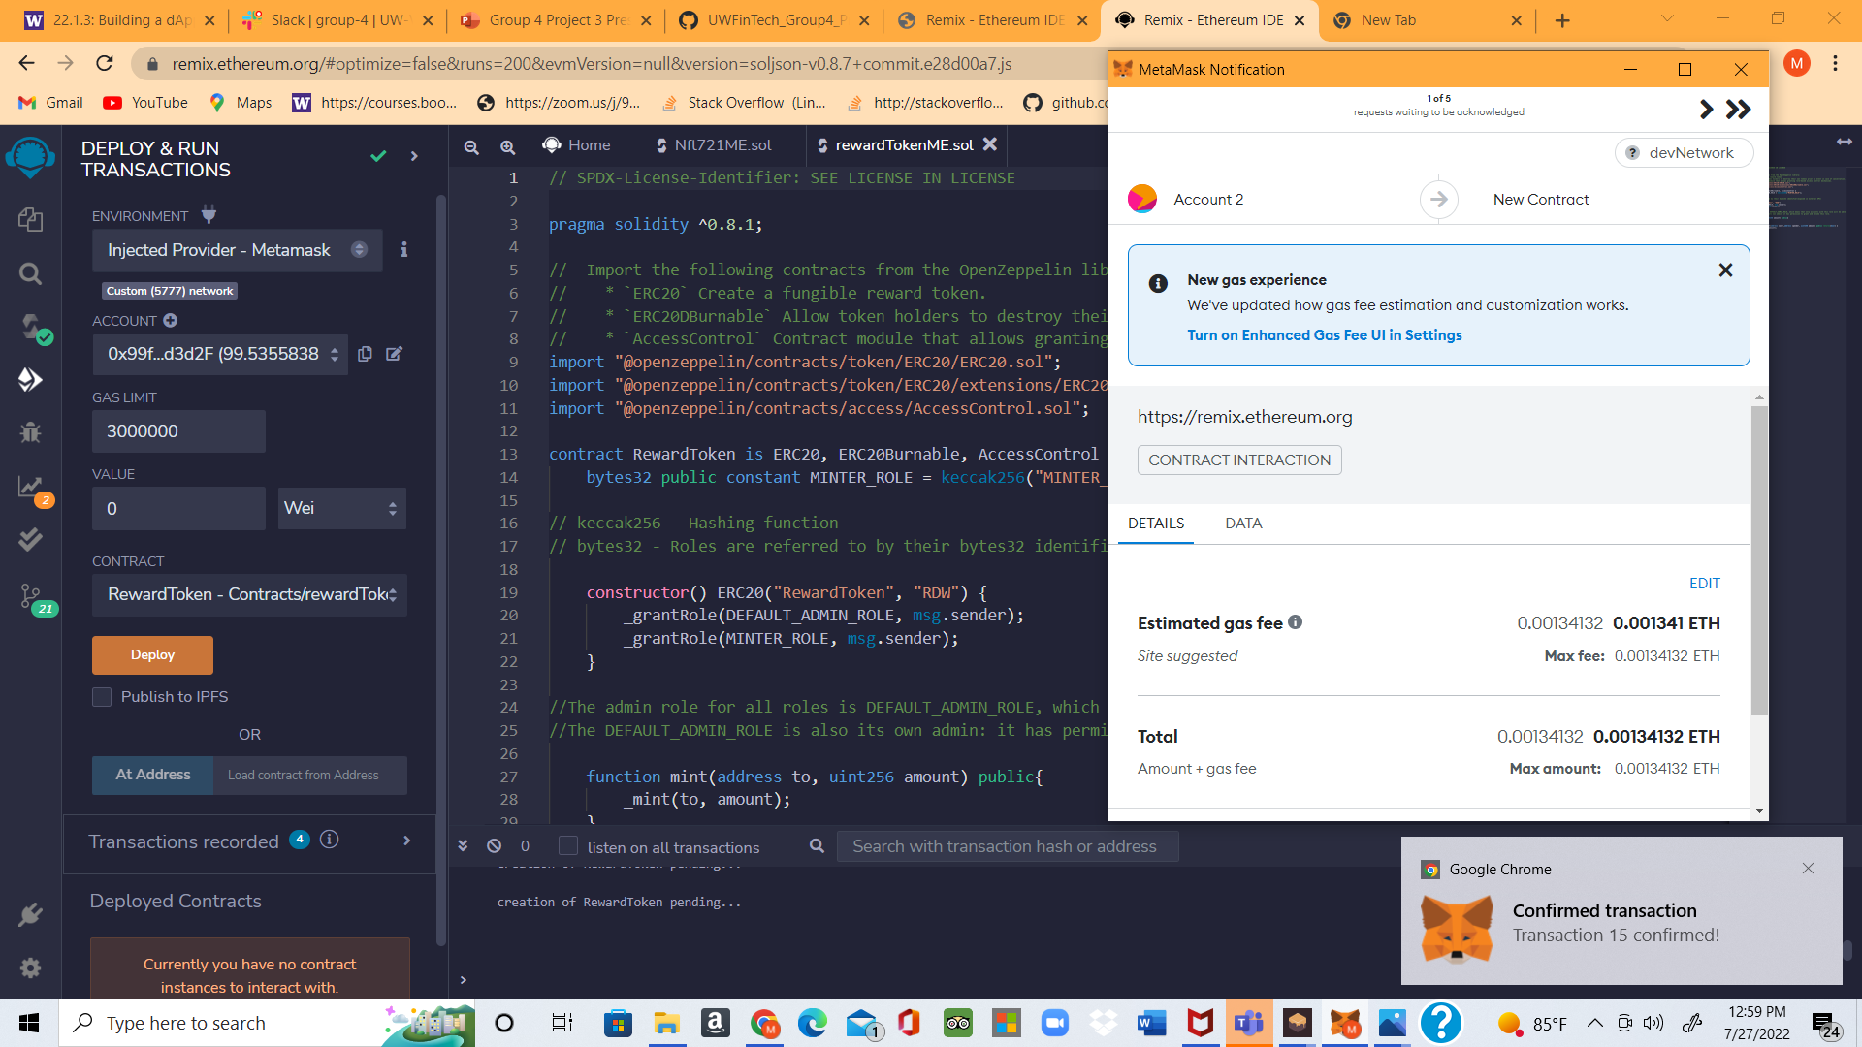
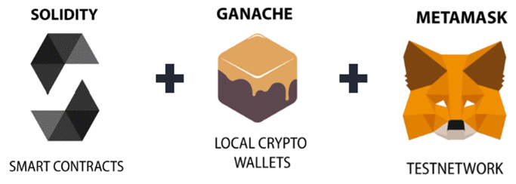
REWARD CONTRACT
Reward Contract Compile & Deploy transaction record

Slide 9
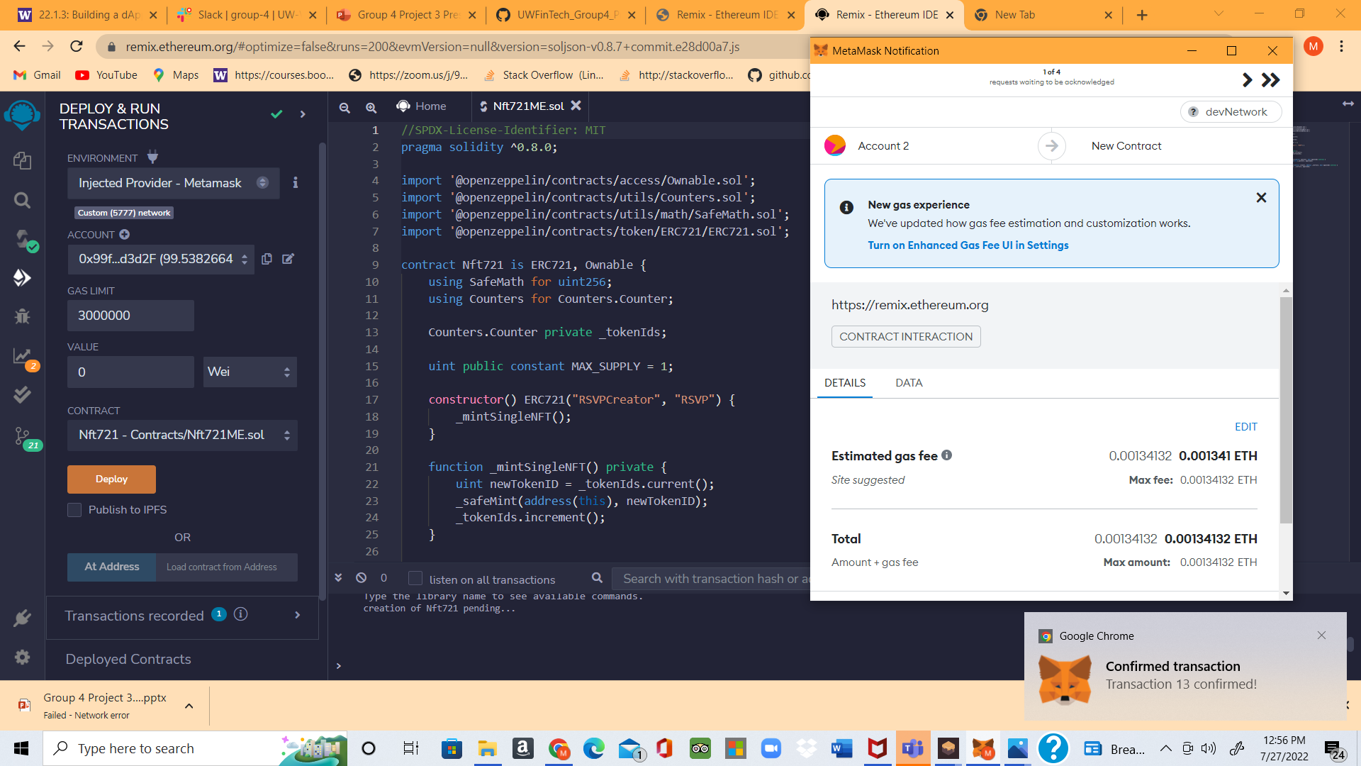
NFT CONTRACT
NFT Contract Compile & Deploy transaction record​

Slide 10
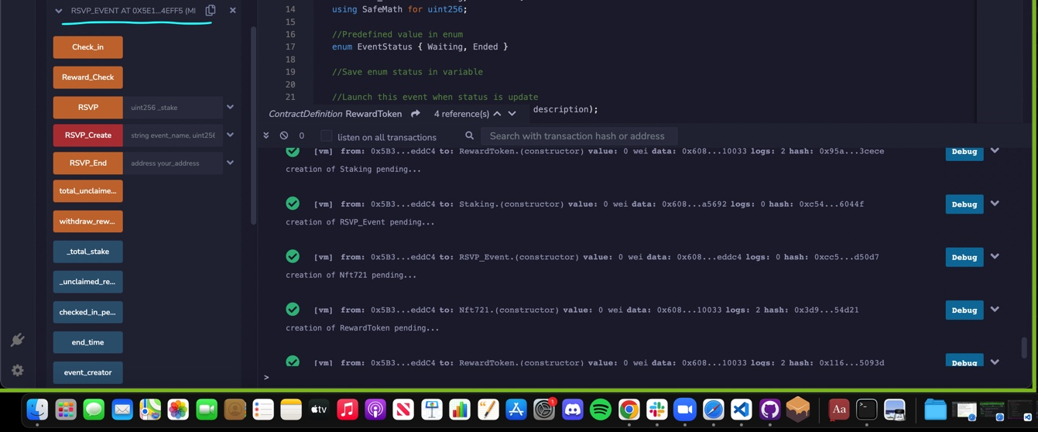
EVENT SAFE , STACKING, RSVP CONTRACT
Contract Compile & Deploy transaction record

Slide 11
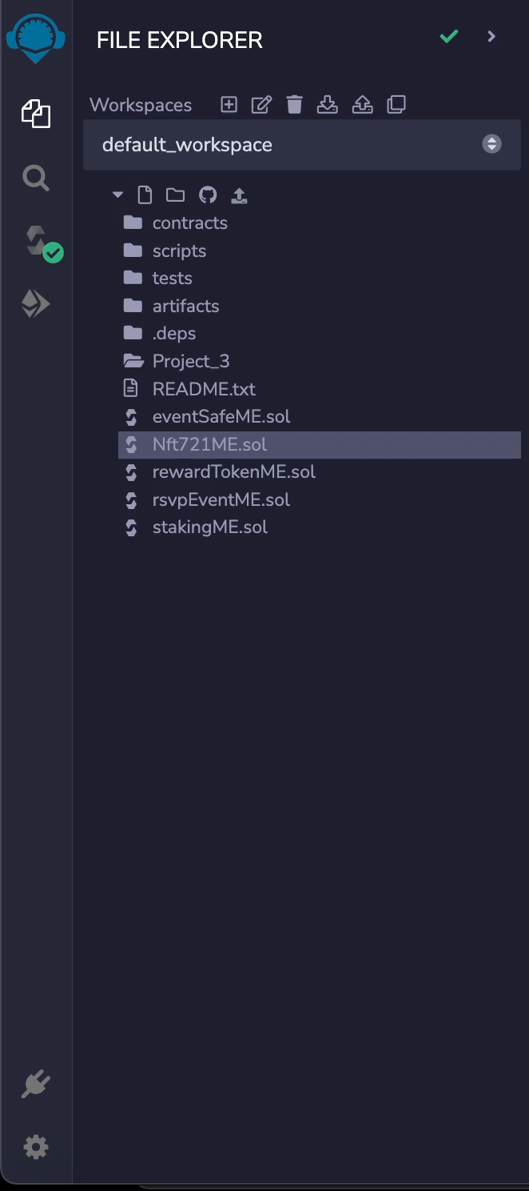
COMPILATION AND DEPLOYMENT OF SMART CONTRACTS (Video Recording )

Slide 12
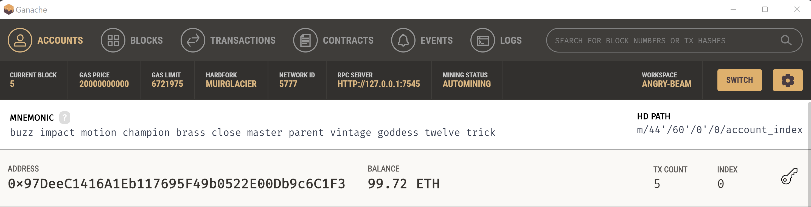
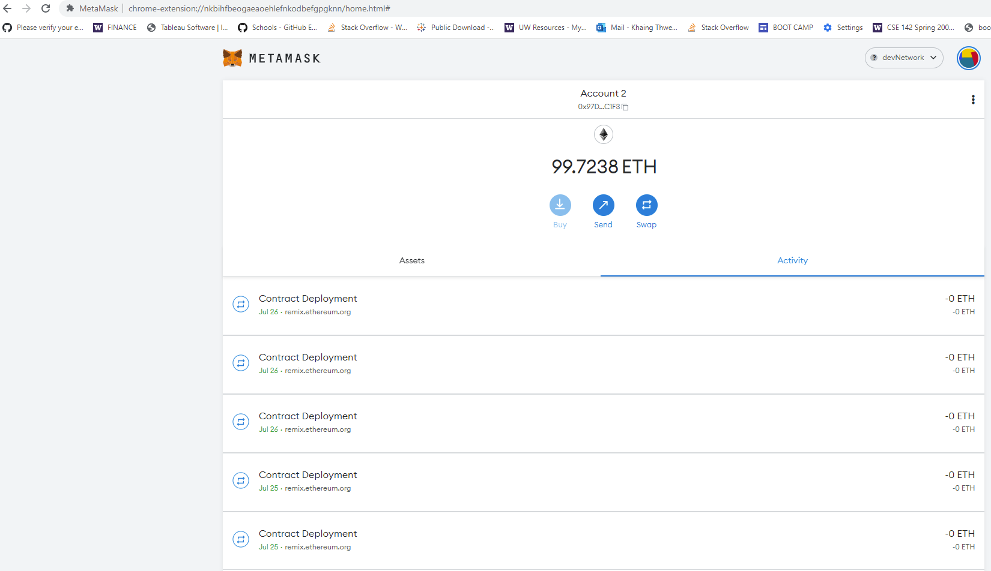
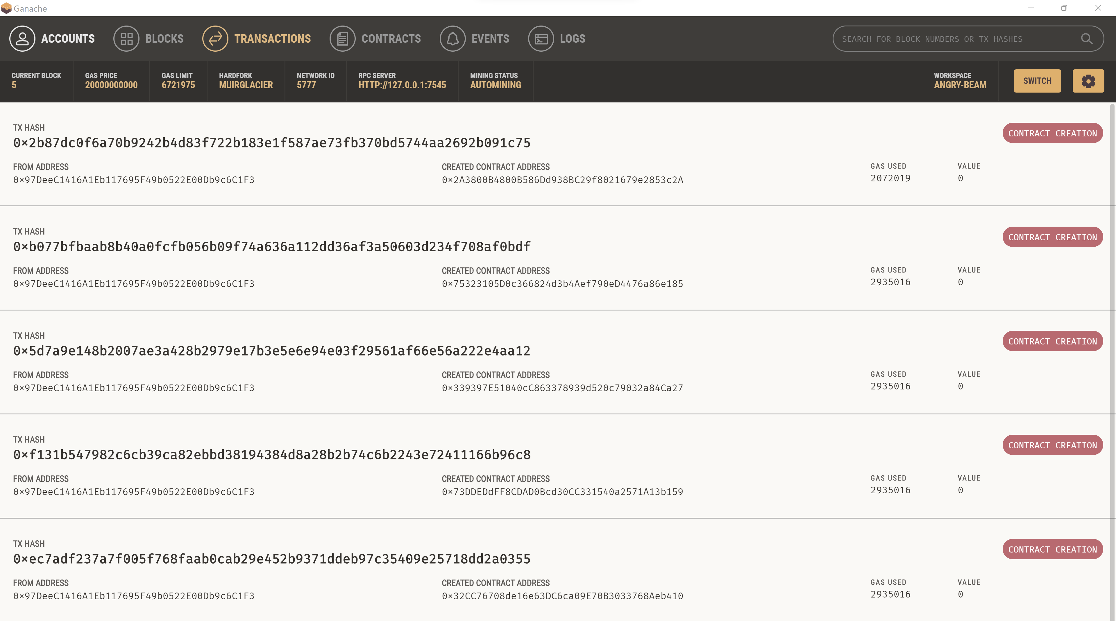
Ganache gas usage record and Transactions Hash
Metamask contract Deployment & account balance

Slide 13
FRONT END PLATFORM
Create:
Construct
ERC721
Unclaimed
Distribution
Validation
RSVP
Validation
Balance check
Pay fee
ERC720
OpenZeppelin
Pool check

Slide 14
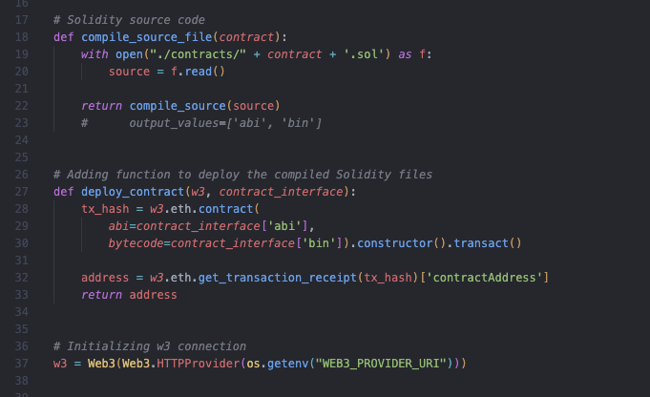
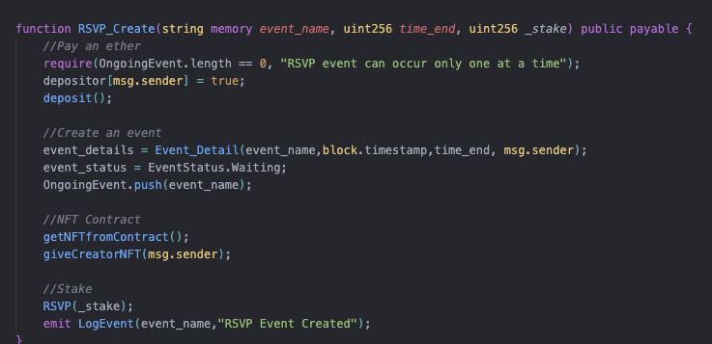
FRONT END PLATFORM

Slide 15
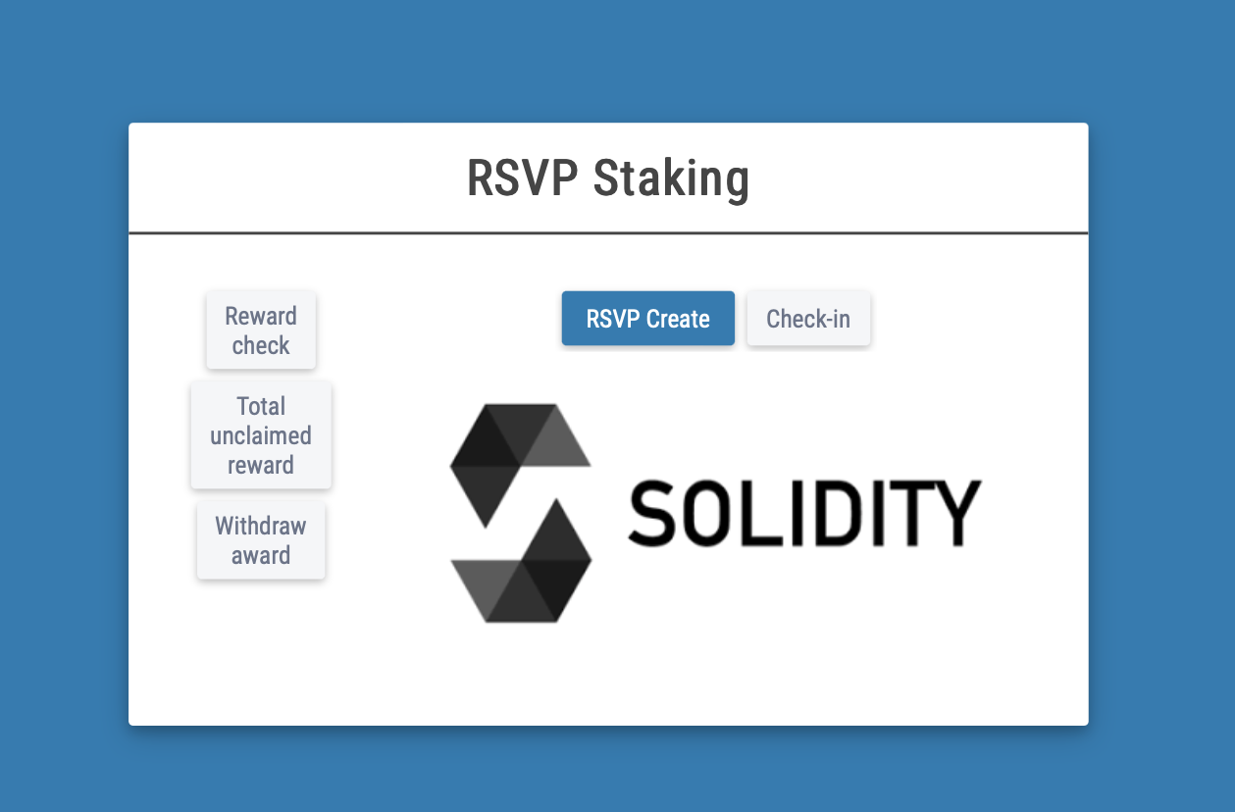
FRONT END PLATFORM

Slide 16

Problem: - Inconsistent event attendance: disincentivizing hosts
Solution:
- A Solidity, smart contract supported, event planning platform

Slide 17

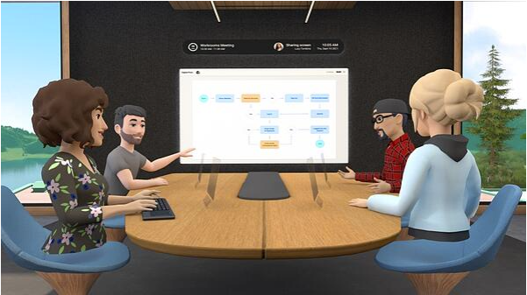
Build the staking event platforms in Metaverse & Decentraland (MANA)
Benefits : Unlimited attendees, the metaverse can host events of any size, from small team building activities to large corporate anniversaries. A participant can visit retail stores or attend virtual events. This can help boost employee engagement and enhanced networking.
Browser based : Users can join from any computer or mobile device. No hardware or VR Goggles required. No software/apps download needed.
Decentraland is a decentralized virtual reality platform built on the Ethereum blockchain network. governed by a Decentralized Autonomous Organization (DAO), collaborate with them to build staking event platforms.
Event Use case : Concerts, casino, Sports, Marketplace, digital assets (land, good, NFT arts).

Slide 18

TEAM
OLGA KORYACHEK
ARTHUR LOVETTE
KHAING THWE
MARCO BERTONE
MAUREEN CALLAHAN

Slide 19
Reference
Acknowledge the source of the original code for the below four solidity contracts files.
## CITATION
### 1 - Nft721ME.sol
Nakglom, Saravut (2022, February 6) Github. solidity-avalanche-RSVP-staking-event/contracts/CreatorERC721.sol https://github.com/SRVng/solidity-avalanche-RSVP-staking-event/blob/ec4c5ed57fc6edff239395e8b7dfa2b387e1bd82/contracts/CreatorERC721.sol
### 2 - eventSafeME.sol
Nakglom, Saravut (2022, February 6) Github. solidity-avalanche-RSVP-staking-event/contracts/EventSafe.sol
https://github.com/SRVng/solidity-avalanche-RSVP-staking-event/blob/main/contracts/EventSafe.sol
### 3 - rsvpEventME.sol
Nakglom, Saravut (2022, February 6) Github. solidity-avalanche-RSVP-staking-event/contracts/RSVP_Event.sol https://github.com/SRVng/solidity-avalanche-RSVP-staking-event/blob/main/contracts/RSVP_Event.sol
### 4 - stakingME.sol
Nakglom, Saravut (2022, February 7) Github. solidity-avalanche-RSVP-staking-event/contracts/Staking.sol
https://github.com/SRVng/solidity-avalanche-RSVP-staking-event/blob/main/contracts/Staking.sol

Slide 20


Slide 21


